Slide 1

Establishing a WAN Connection with Frame Relay
LAN Extension into a WAN
© 2007 Cisco Systems, Inc. All rights reserved.
ICND2 v1.0—8-1
The PDF files and any printed representation for this material are the property of Cisco Systems, Inc., for the sole use by Cisco employees for personal study. The files or printed representations may not be used in commercial training, and may not be distributed for purposes other than individual self-study.

Slide 2
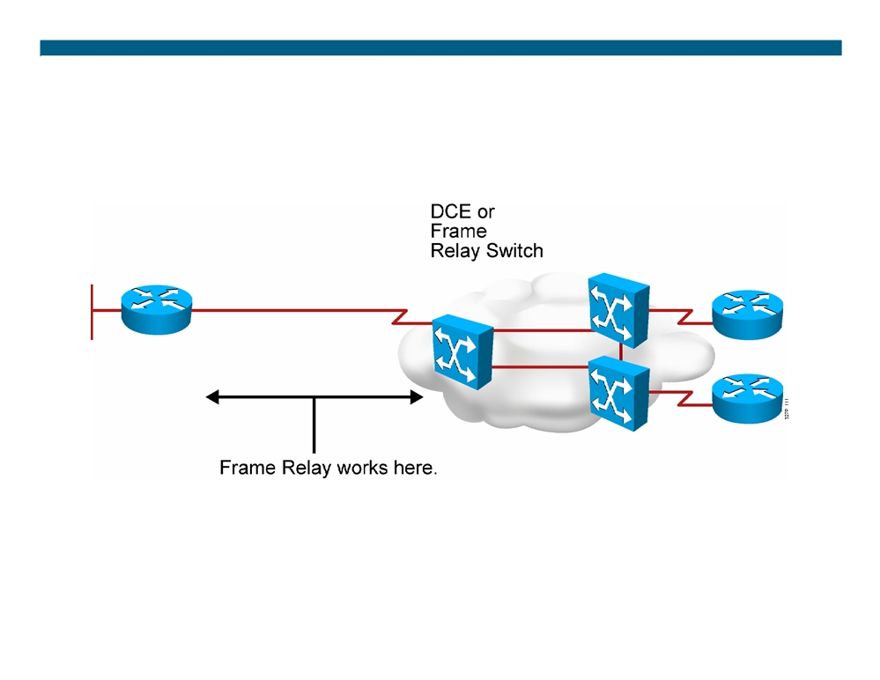
Frame Relay Overview
ƒ Connections made by virtual circuits ƒ Connection-oriented service
© 2007 Cisco Systems, Inc. All rights reserved.
ICND2 v1.0—8-2
The PDF files and any printed representation for this material are the property of Cisco Systems, Inc., for the sole use by Cisco employees for personal study. The files or printed representations may not be used in commercial training, and may not be distributed for purposes other than individual self-study.

Slide 3
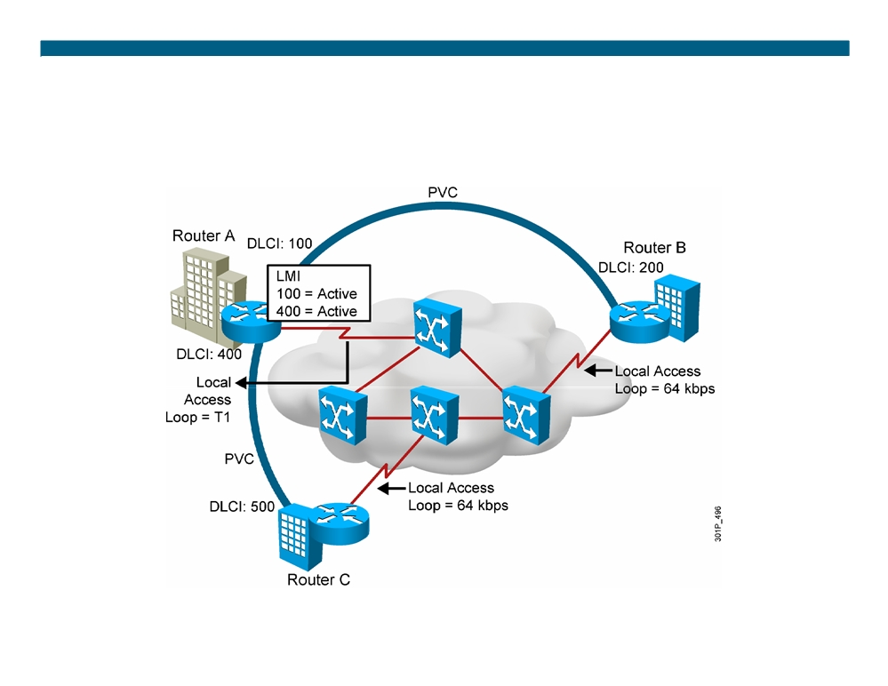
Frame Relay Terminology
© 2007 Cisco Systems, Inc. All rights reserved.
ICND2 v1.0—8-3
The PDF files and any printed representation for this material are the property of Cisco Systems, Inc., for the sole use by Cisco employees for personal study. The files or printed representations may not be used in commercial training, and may not be distributed for purposes other than individual self-study.

Slide 4
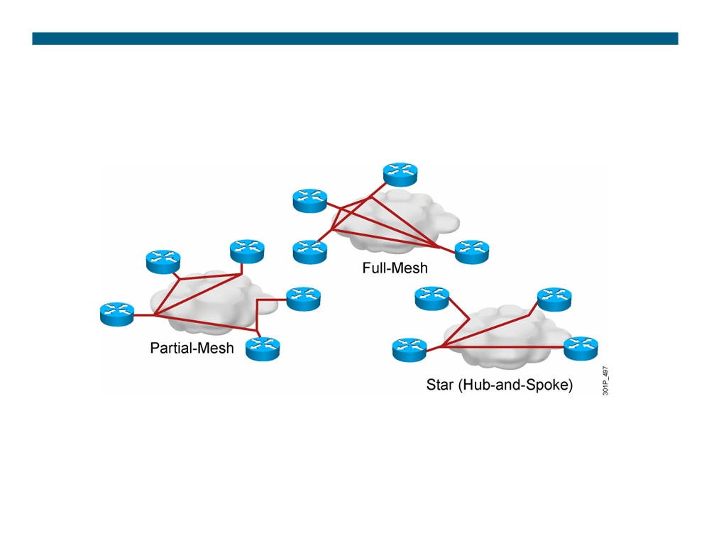
Selecting a Frame Relay Topology
Frame Relay default: NBMA
© 2007 Cisco Systems, Inc. All rights reserved.
ICND2 v1.0—8-4
The PDF files and any printed representation for this material are the property of Cisco Systems, Inc., for the sole use by Cisco employees for personal study. The files or printed representations may not be used in commercial training, and may not be distributed for purposes other than individual self-study.

Slide 5
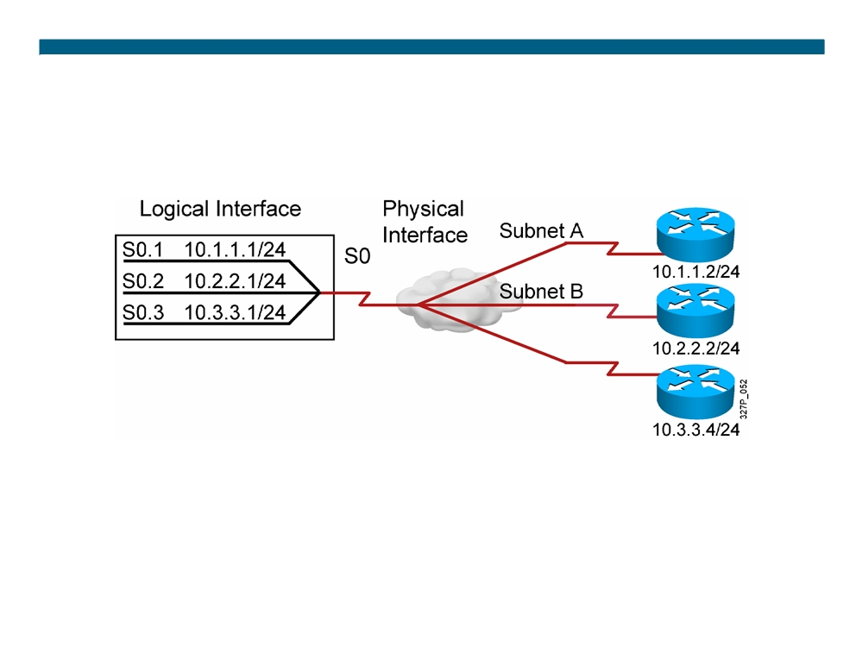
Resolving NBMA Reachability Issues
Split horizon can cause problems in NBMA environments.
ƒ Solution: subinterfaces
ƒ A single physical interface simulates multiple logical interfaces.
© 2007 Cisco Systems, Inc. All rights reserved.
ICND2 v1.0—8-5
The PDF files and any printed representation for this material are the property of Cisco Systems, Inc., for the sole use by Cisco employees for personal study. The files or printed representations may not be used in commercial training, and may not be distributed for purposes other than individual self-study.

Slide 6
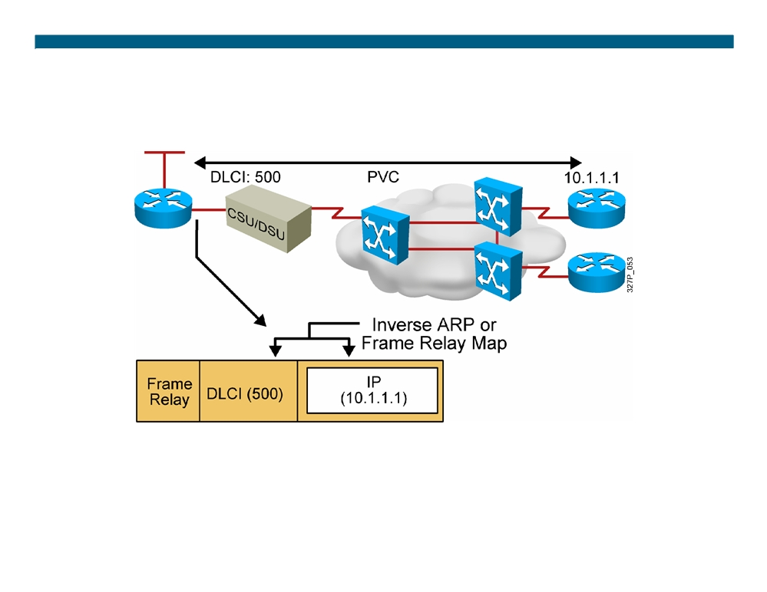
Frame Relay Address Mapping
ƒ LMI receives locally significant DLCI from the Frame Relay switch. ƒ Inverse ARP maps the local DLCI to the remote router network layer address.
© 2007 Cisco Systems, Inc. All rights reserved.
ICND2 v1.0—8-6
The PDF files and any printed representation for this material are the property of Cisco Systems, Inc., for the sole use by Cisco employees for personal study. The files or printed representations may not be used in commercial training, and may not be distributed for purposes other than individual self-study.

Slide 7
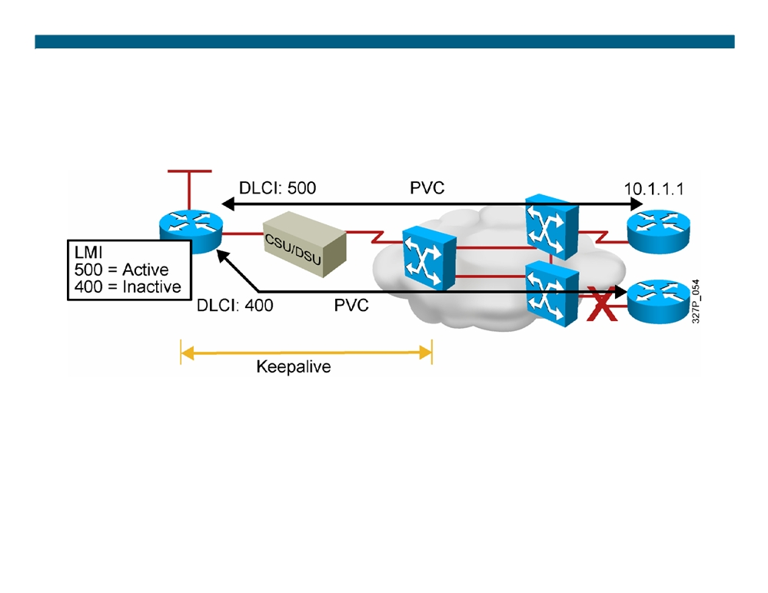
Frame Relay Signaling
Cisco supports three LMI standards:
ƒ Cisco
ƒ ANSI T1.617 Annex D ƒ ITU-T Q.933 Annex A
© 2007 Cisco Systems, Inc. All rights reserved.
ICND2 v1.0—8-7
The PDF files and any printed representation for this material are the property of Cisco Systems, Inc., for the sole use by Cisco employees for personal study. The files or printed representations may not be used in commercial training, and may not be distributed for purposes other than individual self-study.

Slide 8
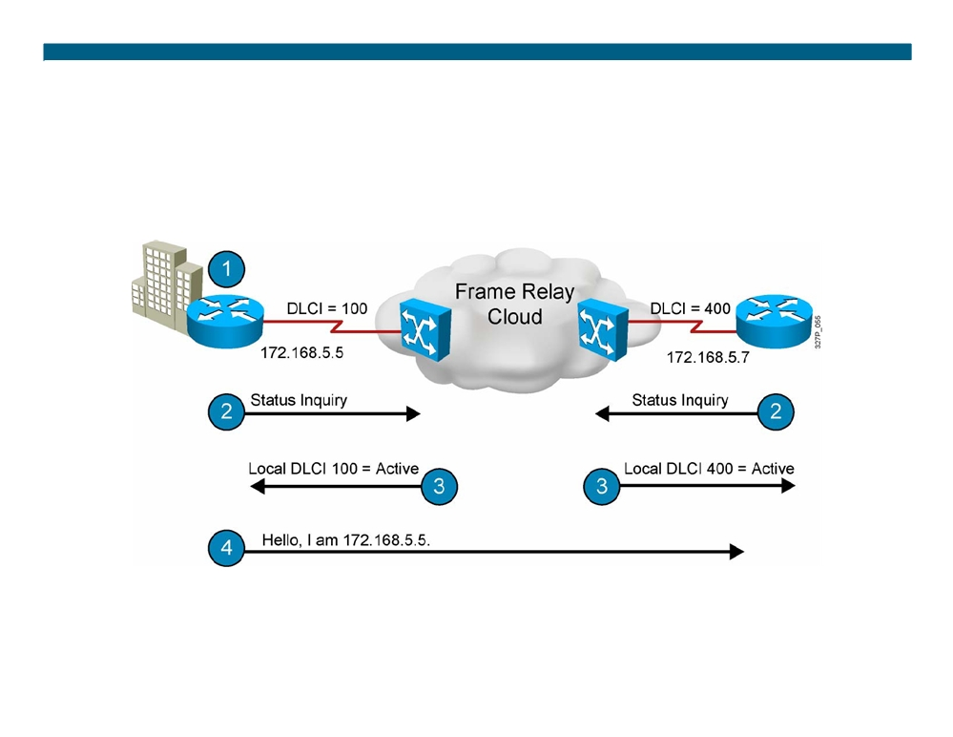
Stages of Inverse ARP and LMI Operation
© 2007 Cisco Systems, Inc. All rights reserved.
ICND2 v1.0—8-8
The PDF files and any printed representation for this material are the property of Cisco Systems, Inc., for the sole use by Cisco employees for personal study. The files or printed representations may not be used in commercial training, and may not be distributed for purposes other than individual self-study.

Slide 9
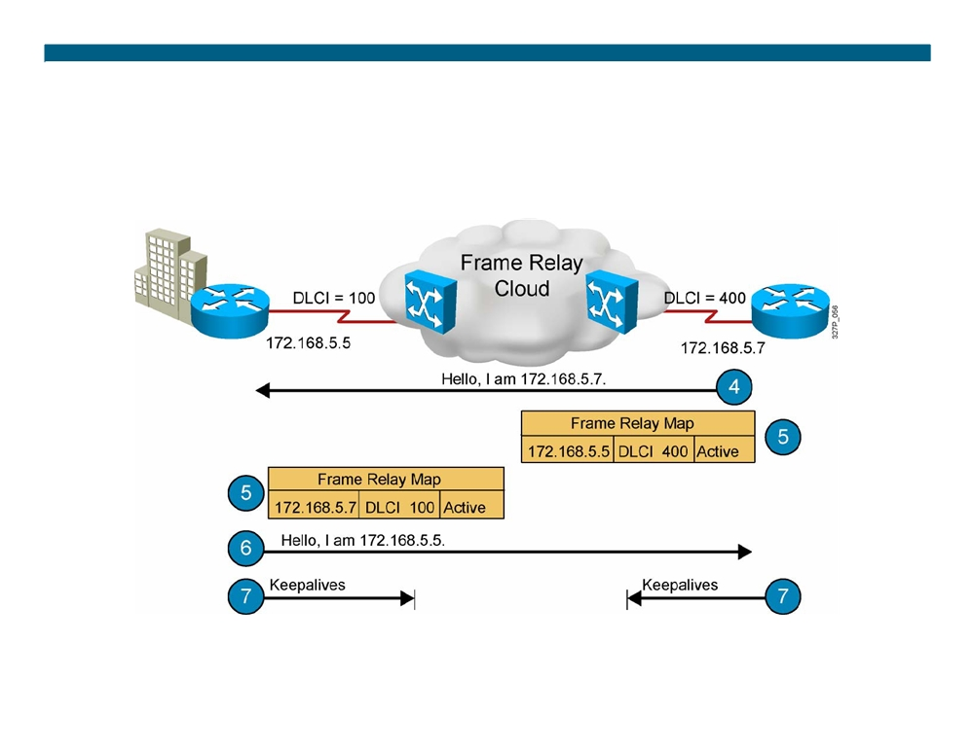
Stages of Inverse ARP and LMI Operation (Cont.)
© 2007 Cisco Systems, Inc. All rights reserved.
ICND2 v1.0—8-9
The PDF files and any printed representation for this material are the property of Cisco Systems, Inc., for the sole use by Cisco employees for personal study. The files or printed representations may not be used in commercial training, and may not be distributed for purposes other than individual self-study.

Slide 10
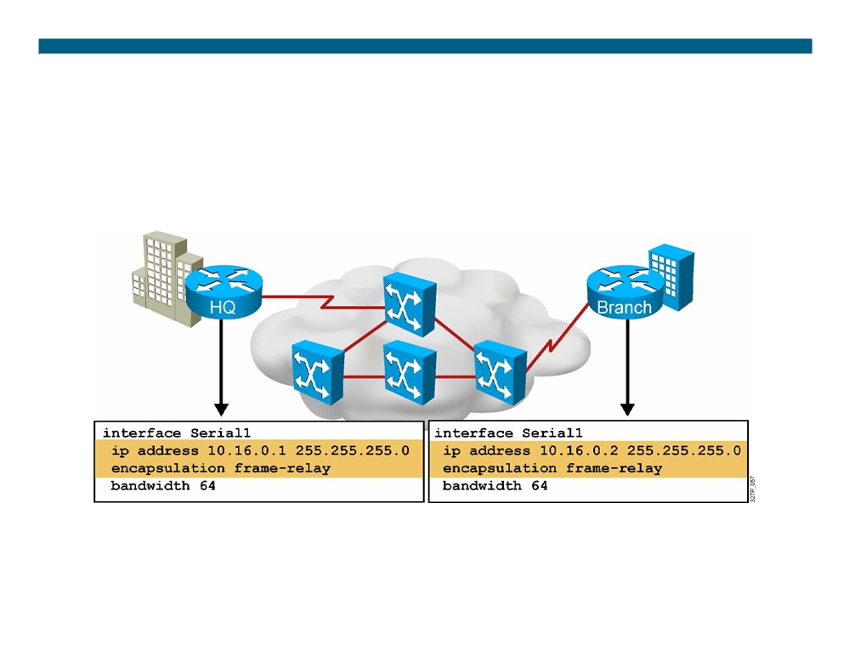
Configuring Basic Frame Relay
© 2007 Cisco Systems, Inc. All rights reserved.
ICND2 v1.0—8-10
The PDF files and any printed representation for this material are the property of Cisco Systems, Inc., for the sole use by Cisco employees for personal study. The files or printed representations may not be used in commercial training, and may not be distributed for purposes other than individual self-study.

Slide 11
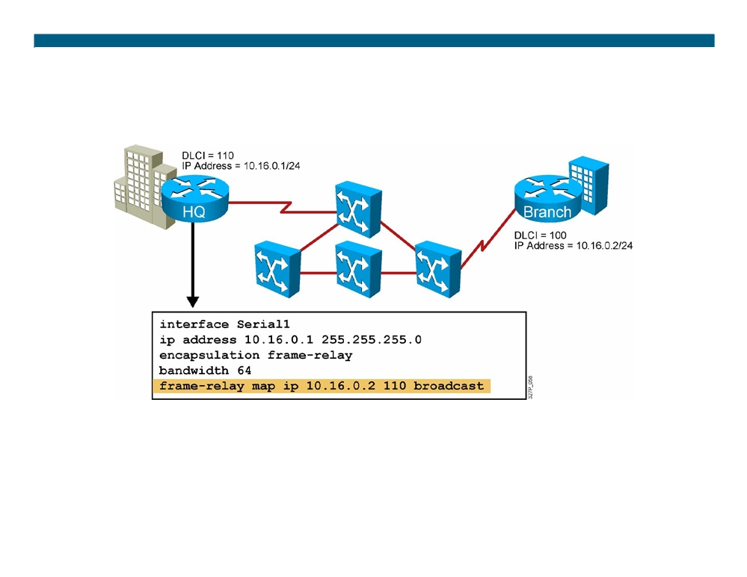
Configuring a Static Frame Relay Map
Configure a static Frame Relay map when:
ƒ A Frame Relay peer does not support Inverse ARP ƒ You want to control broadcast traffic across a PVC
ƒ You want to have different Frame Relay encapsulations across PVCs
© 2007 Cisco Systems, Inc. All rights reserved.
ICND2 v1.0—8-11
The PDF files and any printed representation for this material are the property of Cisco Systems, Inc., for the sole use by Cisco employees for personal study. The files or printed representations may not be used in commercial training, and may not be distributed for purposes other than individual self-study.

Slide 12
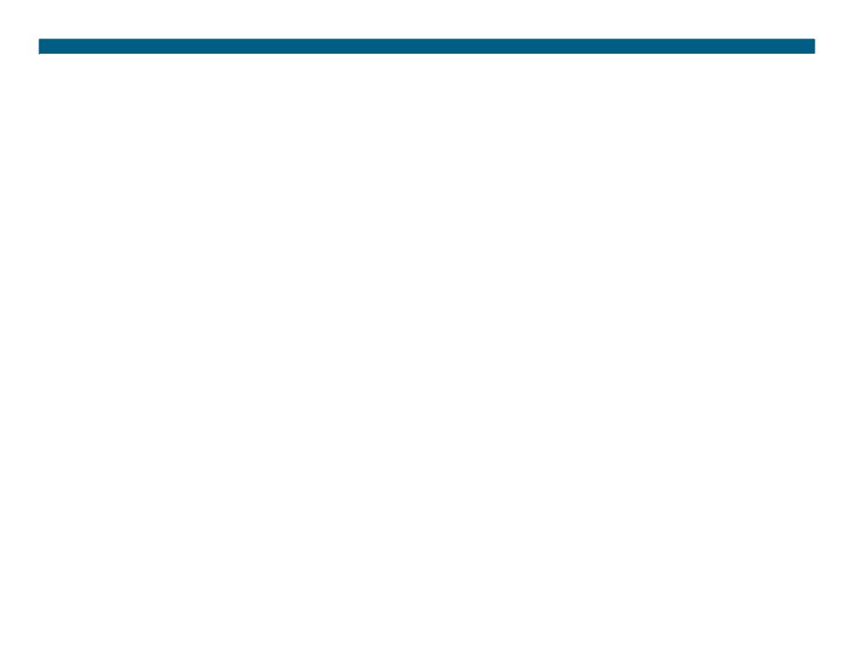
Configuring Frame Relay Subinterfaces
ƒ Point-to-point
- Subinterfaces act like leased lines.
- Each point-to-point subinterface requires its own subnet. - Point-to-point is applicable to hub-and-spoke topologies. ƒ Multipoint
- Subinterfaces act like NBMA networks, so they do not resolve the split-horizon issues.
- Multipoint can save address space because it uses a single subnet.
- Multipoint is applicable to partial-mesh and full-mesh topologies.
© 2007 Cisco Systems, Inc. All rights reserved.
ICND2 v1.0—8-12
The PDF files and any printed representation for this material are the property of Cisco Systems, Inc., for the sole use by Cisco employees for personal study. The files or printed representations may not be used in commercial training, and may not be distributed for purposes other than individual self-study.

Slide 13
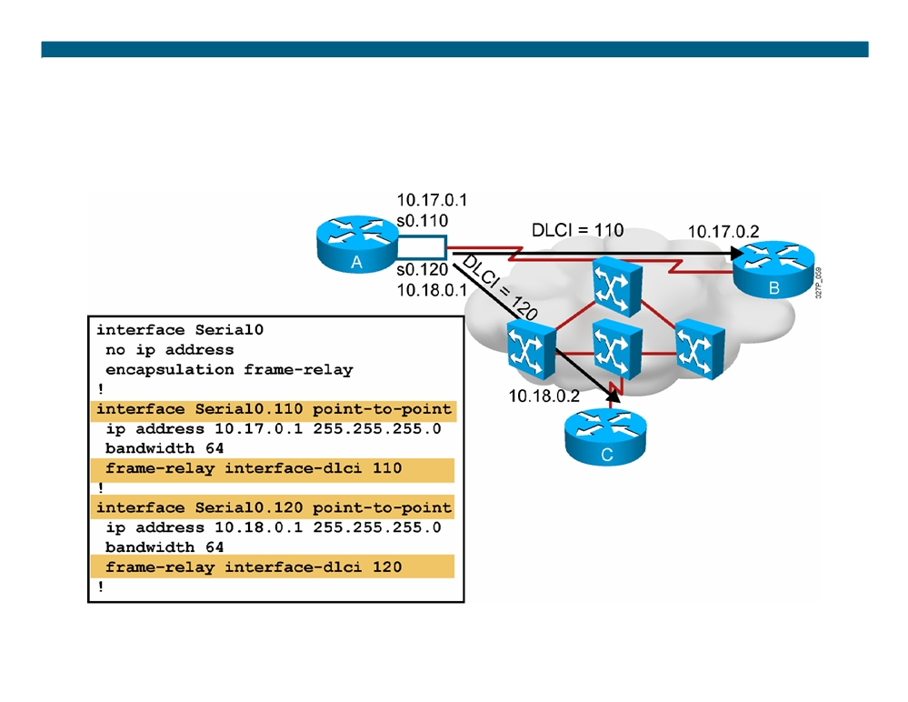
Configuring Frame Relay Point-to-Point Subinterfaces
© 2007 Cisco Systems, Inc. All rights reserved.
ICND2 v1.0—8-13
The PDF files and any printed representation for this material are the property of Cisco Systems, Inc., for the sole use by Cisco employees for personal study. The files or printed representations may not be used in commercial training, and may not be distributed for purposes other than individual self-study.

Slide 14
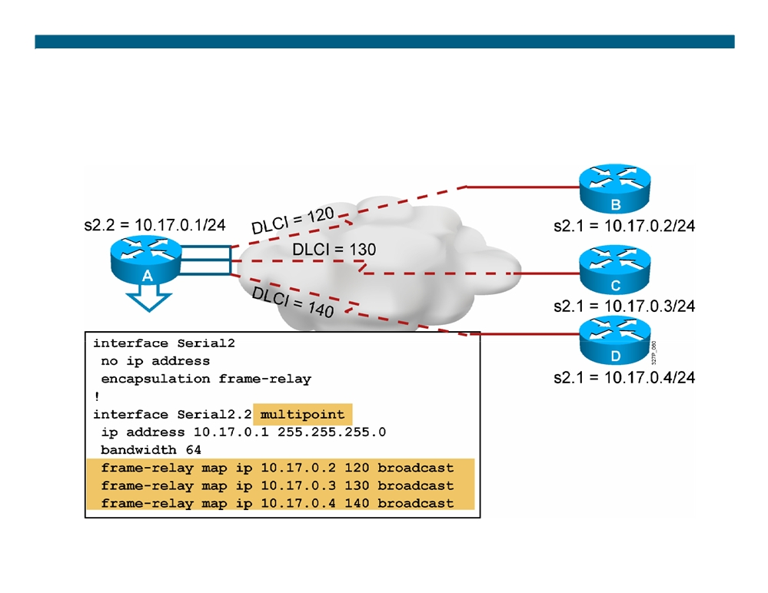
Configuring Frame Relay Multipoint Subinterfaces
© 2007 Cisco Systems, Inc. All rights reserved.
ICND2 v1.0—8-14
The PDF files and any printed representation for this material are the property of Cisco Systems, Inc., for the sole use by Cisco employees for personal study. The files or printed representations may not be used in commercial training, and may not be distributed for purposes other than individual self-study.

Slide 15
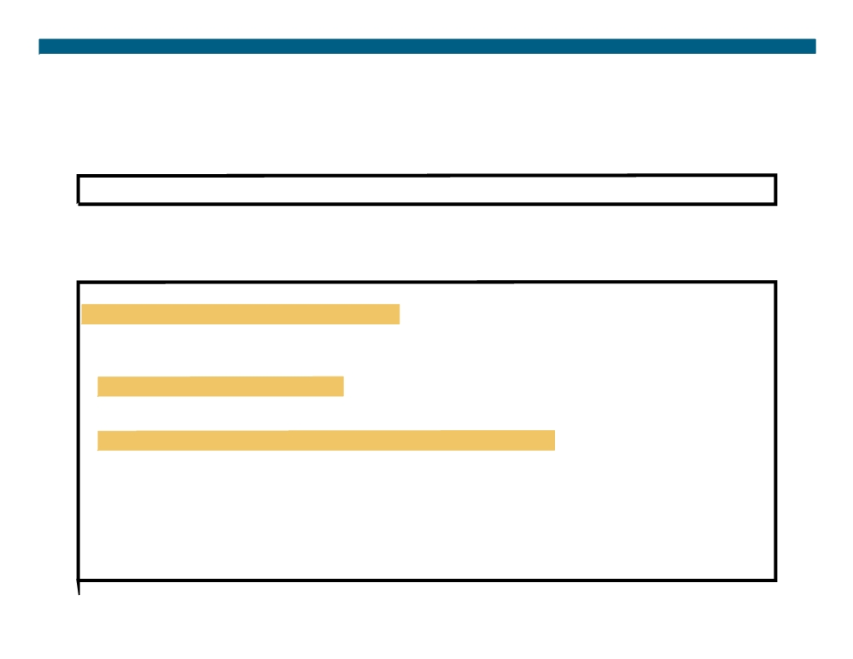
Verifying Frame Relay Operation
RouterX# show interfaces type number
ƒ Displays information about Frame Relay DLCIs and the LMI
RouterX# show interfaces s0
Serial0 is up, line protocol is up Hardware is HD64570
Internet address is 10.140.1.2/24
MTU 1500 bytes, BW 1544 Kbit, DLY 20000 usec, rely 255/255, load 1/255 Encapsulation FRAME-RELAY, loopback not set, keepalive set (10 sec)
LMI enq sent
19, LMI stat recvd 20, LMI upd recvd 0, DTE LMI up
LMI enq recvd 0, LMI stat sent
0, LMI upd sent
0
LMI DLCI 1023 LMI type is CISCO frame relay DTE FR SVC disabled, LAPF state down
Broadcast queue 0/64, broadcasts sent/dropped 8/0, interface broadcasts 5 Last input 00:00:02, output 00:00:02, output hang never Last clearing of "show interface" counters never Queueing strategy: fifo
Output queue 0/40, 0 drops; input queue 0/75, 0 drops <Output omitted>
© 2007 Cisco Systems, Inc. All rights reserved.
ICND2 v1.0—8-15
The PDF files and any printed representation for this material are the property of Cisco Systems, Inc., for the sole use by Cisco employees for personal study. The files or printed representations may not be used in commercial training, and may not be distributed for purposes other than individual self-study.

Slide 16
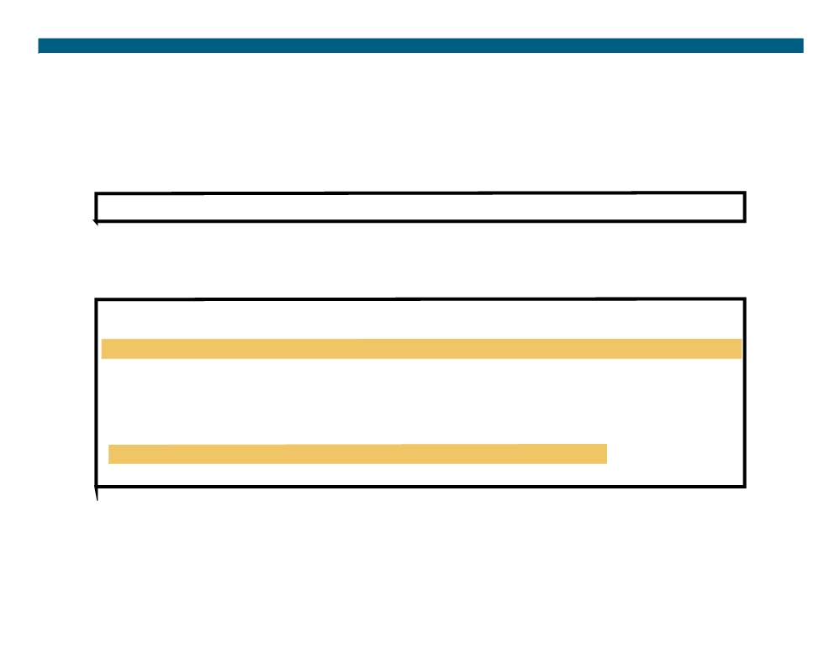
Verifying Frame Relay Operation (Cont.)
RouterX# show frame-relay lmi [type number]
ƒ Displays LMI statistics
RouterX# show frame-relay lmi
LMI Statistics for interface Serial0 (Frame Relay DTE) LMI TYPE = CISCO Invalid Unnumbered info 0 Invalid Prot Disc 0
Invalid dummy Call Ref 0 Invalid Msg Type 0 Invalid Status Message 0 Invalid Lock Shift 0 Invalid Information ID 0 Invalid Report IE Len 0 Invalid Report Request 0 Invalid Keep IE Len 0 Num Status Enq. Sent 113100 Num Status msgs Rcvd 113100 Num Update Status Rcvd 0 Num Status Timeouts 0
© 2007 Cisco Systems, Inc. All rights reserved.
ICND2 v1.0—8-16
The PDF files and any printed representation for this material are the property of Cisco Systems, Inc., for the sole use by Cisco employees for personal study. The files or printed representations may not be used in commercial training, and may not be distributed for purposes other than individual self-study.

Slide 17
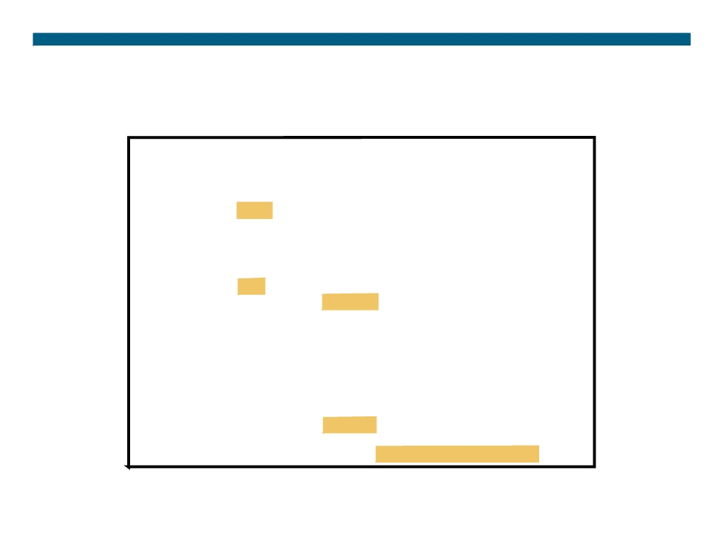
Verifying Frame Relay Operation (Cont.)
RouterX# debug frame-relay lmi
Frame Relay LMI debugging is on Displaying all Frame Relay LMI data RouterX#
1w2d: Serial0(out): StEnq, myseq 140, yourseen 139, DTE up 1w2d: datagramstart = 0xE008EC, datagramsize = 13 1w2d: FR encap = 0xFCF10309
1w2d: 00 75 01 01 01 03 02 8C 8B 1w2d:
1w2d: Serial0(in): Status, myseq 140 1w2d: RT IE 1, length 1, type 1
1w2d: KA IE 3, length 2, yourseq 140, myseq 140 1w2d: Serial0(out): StEnq, myseq 141, yourseen 140, DTE up 1w2d: datagramstart = 0xE008EC, datagramsize = 13 1w2d: FR encap = 0xFCF10309
1w2d: 00 75 01 01 01 03 02 8D 8C 1w2d:
1w2d: Serial0(in): Status, myseq 142 1w2d: RT IE 1, length 1, type 0
1w2d: KA IE 3, length 2, yourseq 142, myseq 142 1w2d: PVC IE 0x7 , length 0x6 , dlci 100, status 0x2 , bw 0
ƒ Displays LMI debug information
© 2007 Cisco Systems, Inc. All rights reserved.
ICND2 v1.0—8-17
The PDF files and any printed representation for this material are the property of Cisco Systems, Inc., for the sole use by Cisco employees for personal study. The files or printed representations may not be used in commercial training, and may not be distributed for purposes other than individual self-study.

Slide 18
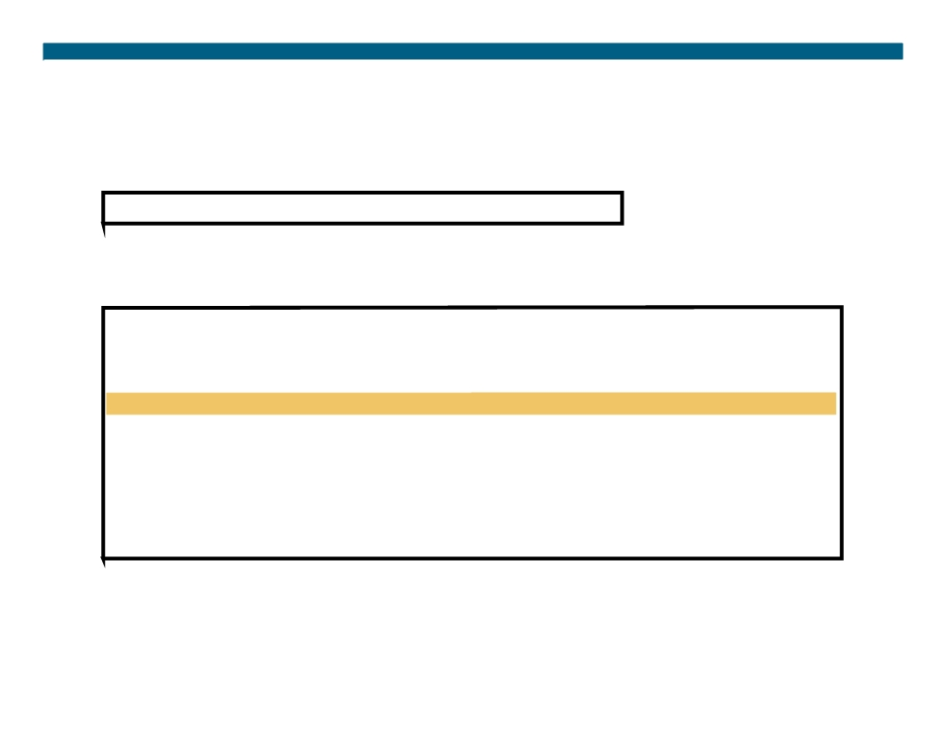
Verifying Frame Relay Operation (Cont.)
RouterX# show frame-relay pvc [type number [dlci]]
ƒ Displays PVC statistics
RouterX# show frame-relay pvc 100
PVC Statistics for interface Serial0 (Frame Relay DTE) DLCI = 100, DLCI USAGE = LOCAL, PVC STATUS = ACTIVE, INTERFACE = Serial0
input pkts 28
output pkts 10
in bytes 8398
out bytes 1198
dropped pkts 0
in FECN pkts 0
in BECN pkts 0
out FECN pkts 0
out BECN pkts 0
in DE pkts 0
out DE pkts 0
out bcast pkts 10
out bcast bytes 1198
pvc create time 00:03:46, last time pvc status changed 00:03:47
© 2007 Cisco Systems, Inc. All rights reserved.
ICND2 v1.0—8-18
The PDF files and any printed representation for this material are the property of Cisco Systems, Inc., for the sole use by Cisco employees for personal study. The files or printed representations may not be used in commercial training, and may not be distributed for purposes other than individual self-study.

Slide 19
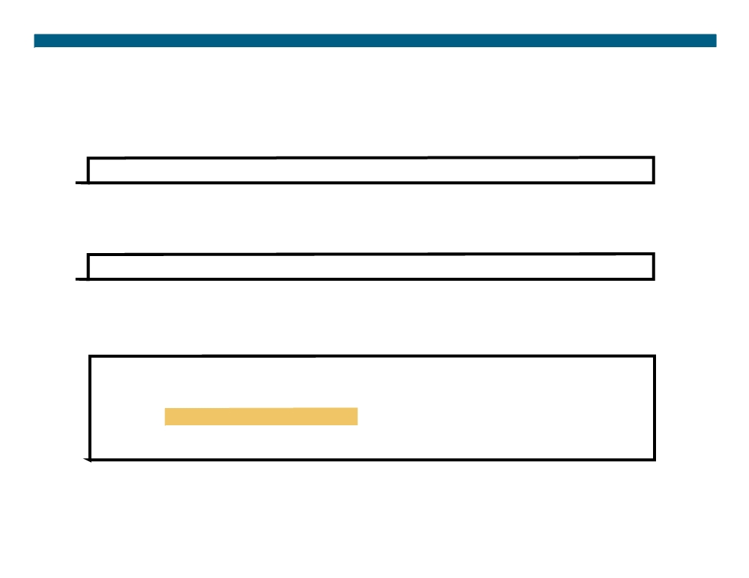
Verifying Frame Relay Operation (Cont.)
RouterX# show frame-relay map
ƒ Displays the current Frame Relay map entries
RouterX# clear frame-relay-inarp
ƒ Clears dynamically created Frame Relay maps, created by using Inverse ARP
RouterX# show frame-relay map
Serial0 (up): ip 10.140.1.1 dlci 100(0x64,0x1840), dynamic, broadcast,, status defined, active
RouterX# clear frame-relay-inarp RouterX# show frame map
RouterX#
© 2007 Cisco Systems, Inc. All rights reserved.
ICND2 v1.0—8-19
The PDF files and any printed representation for this material are the property of Cisco Systems, Inc., for the sole use by Cisco employees for personal study. The files or printed representations may not be used in commercial training, and may not be distributed for purposes other than individual self-study.

Slide 20
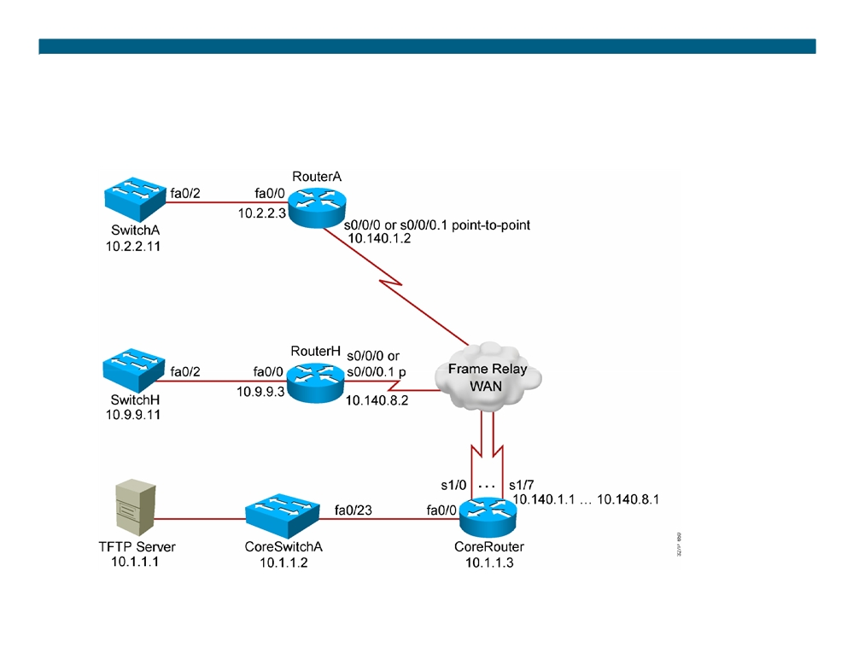
Visual Objective 8-1:
Establishing a Frame Relay WAN
WG Router s0/0/0
A
10.140.1.2
B
10.140.2.2
C
10.140.3.2
D
10.140.4.2
E
10.140.5.2
F
10.140.6.2
G
10.140.7.2
H
10.140.8.2
© 2007 Cisco Systems, Inc. All rights reserved.
ICND2 v1.0—8-20
The PDF files and any printed representation for this material are the property of Cisco Systems, Inc., for the sole use by Cisco employees for personal study. The files or printed representations may not be used in commercial training, and may not be distributed for purposes other than individual self-study.

Slide 21
Summary
ƒ Frame Relay PVCs are identified with DLCIs, and the status of the PVCs are reported via the LMI protocol.
ƒ Frame Relay point-to-point subinterfaces require a separate subnet for each PVC, and multipoint subinterfaces share a single subnet with frame relay peers.
ƒ To display connectivity with the Frame Relay provider, use the show frame-relay lmi command. To display connectivity with the Frame Relay peer, use the show frame-relay pvc and show frame-relay map commands.
© 2007 Cisco Systems, Inc. All rights reserved.
ICND2 v1.0—8-21
The PDF files and any printed representation for this material are the property of Cisco Systems, Inc., for the sole use by Cisco employees for personal study. The files or printed representations may not be used in commercial training, and may not be distributed for purposes other than individual self-study.

Slide 22

© 2007 Cisco Systems, Inc. All rights reserved.
ICND2 v1.0—8-22 The PDF files and any printed representation for this material are the property of Cisco Systems, Inc., for the sole use by Cisco employees for personal study. The files or printed representations may not be used in commercial training, and may not be distributed for purposes other than individual self-study.

Slide 23
Module Summary
ƒ Site-to-site VPNs secure traffic between intranet and extranet peers. Remote-access VPNs secure communications from the telecommuter to the central office.
ƒ PPP can be configured on both asynchronous and synchronous point-to-point links. PPP supports both PAP and CHAP authentication.
ƒ Frame Relay interfaces can be either point-to-point or multipoint interfaces.
ƒ To troubleshoot Frame Relay connections, use the commands show frame relay lmi, show frame relay pvc, and show frame relay map.
© 2007 Cisco Systems, Inc. All rights reserved.
ICND2 v1.0—8-1
The PDF files and any printed representation for this material are the property of Cisco Systems, Inc., for the sole use by Cisco employees for personal study. The files or printed representations may not be used in commercial training, and may not be distributed for purposes other than individual self-study.

Slide 24
© 2007 Cisco Systems, Inc. All rights reserved.
ICND2 v1.0—8-2 The PDF files and any printed representation for this material are the property of Cisco Systems, Inc., for the sole use by Cisco employees for personal study. The files or printed representations may not be used in commercial training, and may not be distributed for purposes other than individual self-study.

